Slide 1
Topic
Applications of Fuzzy Sets (Contd..)

Slide 2
Hierarchical Fuzzy Logic Controller
Let us assume that a process having n inputs (I₁,I₂,……I_{n}) and one output (that is, O) is to be modeled using an FLC

Slide 3
Let us also assume that m linguistic terms (fuzzy sets) are used to represent each variable.
Total no. of rules = m^{n}
Problem : curse of dimensionality

Slide 4
To overcome this problem, we go for Hierarchical Fuzzy Logic Controller
Total no. of rules = m²(n-1)

Slide 5
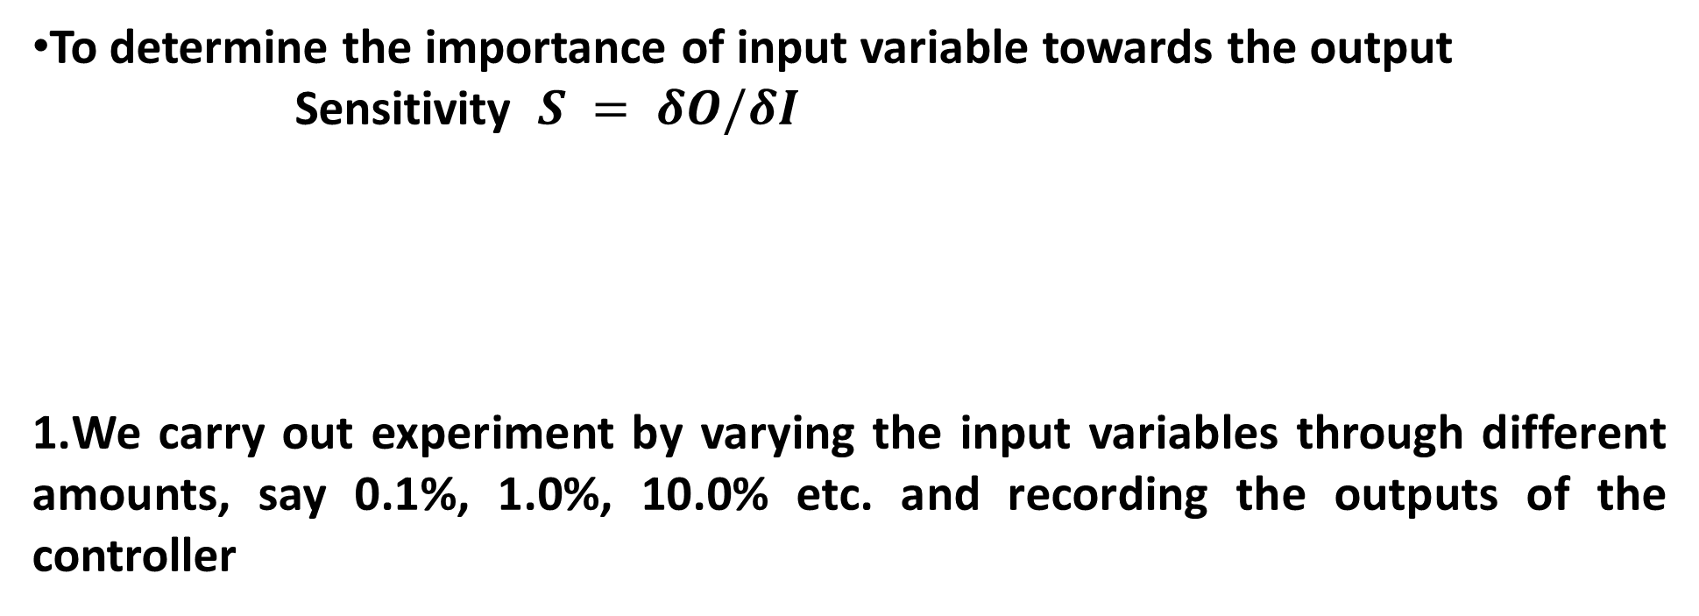
Sensitivity Analysis
To determine the importance of input variable towards the output
Sensitivity $S = δO/δI$
We carry out experiment by varying the input variables through different amounts, say 0.1%, 1.0%, 10.0% etc. and recording the outputs of the controller
Methods to Determine Sensitivity

Slide 6
2.O = f(I₁, I₂)
We change the input I₁ by a small amount δI₁ and determine the change in output using Mean-Value theorem

Slide 7
Where lies between I₁ and I₁+δI₁
If then δO > δI₁
Thus, the contribution of I₁ on the output O can be determined.

Slide 8
Advantages of FLC
Potential tool for dealing with imprecision and uncertainty
Does not require an extensive mathematical formulation of the problem

Slide 9
Disadvantages of FLC
Designing a proper KB of an FLC is a difficult task
May not be suitable for modeling a process involving many variables

Slide 10
Fuzzy Clustering
Clustering is a powerful tool of data mining
In clustering, grouping of data into several clusters is done based on their similarity among them
Clusters could be either crisp or fuzzy in nature
Several methods of fuzzy clustering: Fuzzy C-Means Algorithm, Potential-based Clustering, Entropy-based Clustering, and others

Slide 11
Fuzzy C-Means Clustering
Proposed by Bezdek in 1973
A particular data of the set may be the member of several clusters with different values of membership
An attempt is made to minimize dissimilarity measure (expressed in terms of Euclidean distance) of the data points with the pre-defined clusters

Slide 12
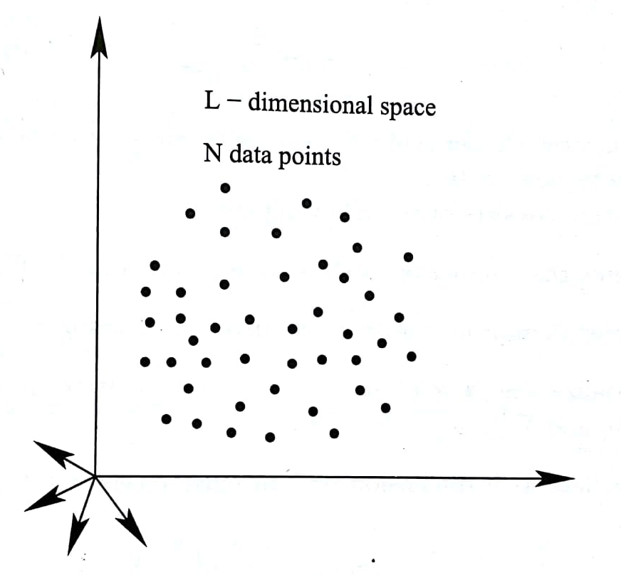
Fuzzy C-Means Clustering

Slide 13
Fuzzy C-Means Clustering

Slide 14
Fuzzy C-Means Clustering

Slide 15
An iterative algorithm, in which the cluster centers and membership values of the data points with the clusters are updated to minimize the dissimilarity measure

Slide 16
Steps of FCM Algorithm
Step 1: Assume the number of clusters to be made, that is, C
2 ≤ C ≤ N
Step 2: Choose an appropriate level of cluster fuzziness g > 1
Step 3: μ_{ij}: Membership value of i-th data point with j- th cluster. Initialize the N×C sized membership matrix [μ] at random, such that μ_{ij} [0.0, 1.0] and , for each i

Slide 17
Step 4: Calculate k-th dimension of j-th cluster center CC_{jk} as follows:
Step 5: Calculate the Euclidean distance between i-th data point and j-th cluster center, that is, d_{ij}

Slide 18
Step 6: Update fuzzy membership matrix [μ] according to d_{ij}
, if d_{ij} > 0
= 1.0, if d_{ij} = 0
Step 7: Repeat from step 4 to step 6 until the changes in [μ]
come out to be less than some pre-specified values

Slide 19
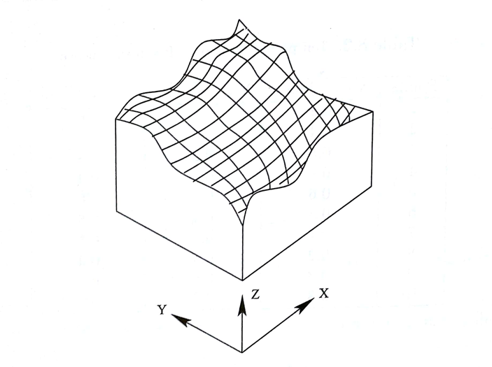
Numerical Example
Ten points lying on a free-form surface are shown below.
Figure: Free-form surface

Slide 20
Points | X-coordinate | Y-coordinate | Z-coordinate
1 | 0.2 | 0.4 | 0.6
2 | 0.4 | 0.3 | 0.8
3 | 0.8 | 0.2 | 0.5
4 | 0.9 | 0.5 | 0.4
5 | 0.6 | 0.6 | 0.6
6 | 0.3 | 0.4 | 0.5
7 | 0.7 | 0.6 | 0.5
8 | 0.2 | 0.5 | 0.3
9 | 0.3 | 0.6 | 0.8
10 | 0.8 | 0.3 | 0.1
Carry out clustering using the fuzzy C-means algorithm.
Assume g = 1.25, termination criterion ε = 0.01.

Slide 21
Solution:
Number of data points to be considered N = 10
Dimensions of the data L = 3
Level of cluster fuzziness g = 1.25
Let us assume that the number of clusters to be made C = 2 .

Slide 22
Let us also suppose that a membership matrix [µ] of size 10×2 is generated at random, as given below.

Slide 23
The first dimension of first cluster center CC₁₁ is determined as follows:

Slide 31
Entropy-Based Fuzzy Clustering
Entropy is an index determined based on a similarity measure, which depends on Euclidean distance
The data point having the minimum entropy value is selected as the cluster center
The data points having similarity with this cluster center more than a pre-specified value will form a cluster

Slide 32
Entropy-based Fuzzy Clustering

Slide 33
Let us consider N data points in L-D hyperspace
Step 1: Arrange the data set in N rows and L columns
Step 2: Calculate Euclidean distance between the points i and j as follows:

Slide 34
Step 3: Determine the similarity S_{ij} between two data points i and j
where α is a constant to be determined

Slide 35
Let us assume a similarity of 0.5, when the distance between two data points d_{ij} becomes equal to mean distance of all pairs of data points.
We get
Note: S_{ij} varies in the range of 0.0 to 1.0

Slide 36
Step 4: Calculate the entropy E of all N data points
Step 5: Determine total entropy value at a data point x_{i}
with respect to all other data points

Slide 37

Clustering Algorithm
Step 1: Calculate entropy E_{i} for each data point x_{i} lying in [T]
Step 2: Identify x_{i} that has the minimum E_{i} value and select it as the cluster center
${(x}_{i,min})$

Slide 38
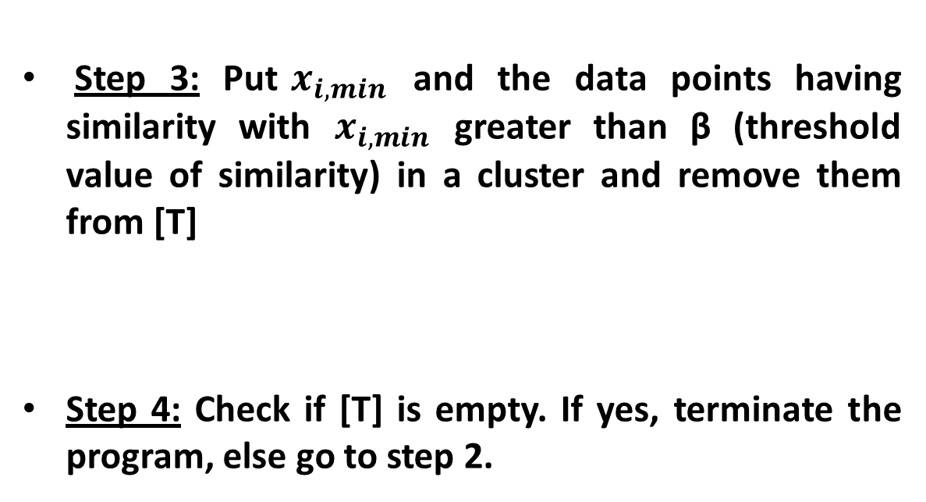
Step 3: Put$x_{i,min}$ and the data points having similarity with $x_{i,min}$ greater than β (threshold value of similarity) in a cluster and remove them from [T]
Step 4: Check if [T] is empty. If yes, terminate the program, else go to step 2.

Slide 39
Concept of Outliers
After the clustering is done, we count the number of data points lying in each cluster and if this number becomes greater than or equal to γ% of total number of data points, we declare this cluster to be a valid one. Otherwise, these data points will be declared as the outliers.

Slide 40

Numerical Example
Figure: Free-form surface
Ten points lying on a free-form surface are shown in the table.

Slide 41
Points | X-coordinate | Y-coordinate | Z-coordinate
1 | 0.2 | 0.4 | 0.6
2 | 0.4 | 0.3 | 0.8
3 | 0.8 | 0.2 | 0.5
4 | 0.9 | 0.5 | 0.4
5 | 0.6 | 0.6 | 0.6
6 | 0.3 | 0.4 | 0.5
7 | 0.7 | 0.6 | 0.5
8 | 0.2 | 0.5 | 0.3
9 | 0.3 | 0.6 | 0.8
10 | 0.8 | 0.3 | 0.1
Carry out fuzzy clustering based on their similarity and entropy values. Assume β=0.5, γ=10%.

Slide 42
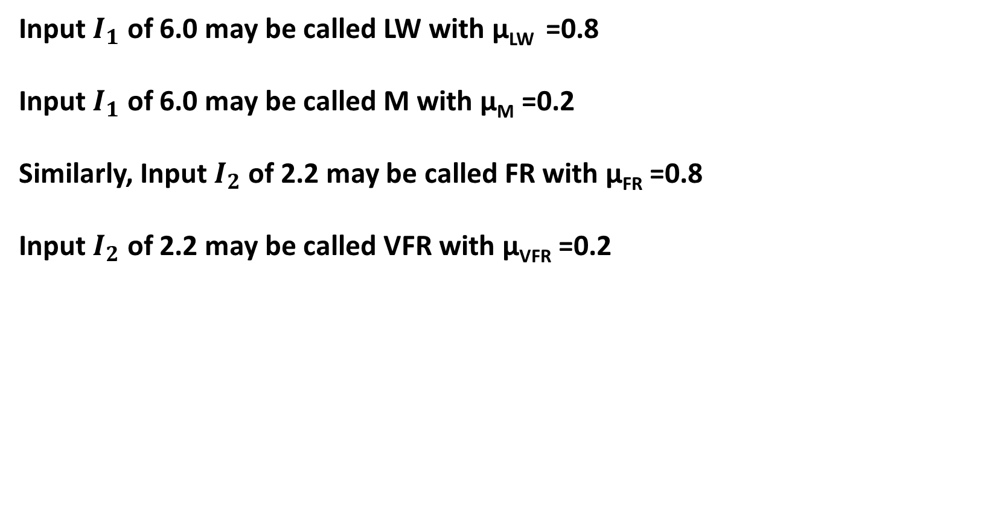
Solution:
Calculate Euclidean distance between two points: i and j
$$d_{ij}=\sqrt{\sum_{k=1}^{L}{{(x_{ik}−x_{jk})}^{2}}}$$
Here, number of data points N=10

Slide 43
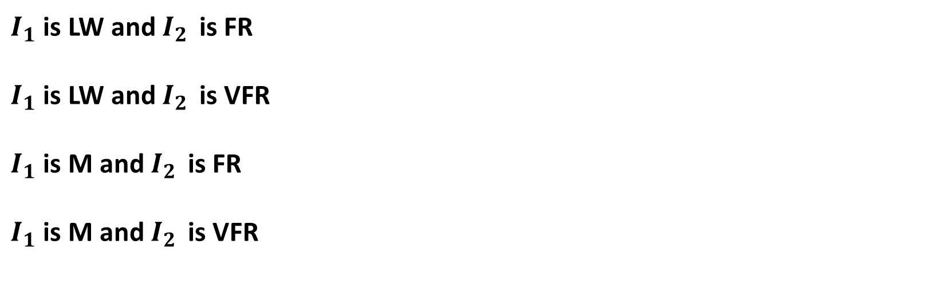
There will be ${10}_{C_{2}}=45$ distance values ($d_{ij}$)
$d_{ji}$=$d_{ij}$
and
$$d_{00}=d_{11}=d_{22}=d_{33}=−−−−−=d_{99}=0.0$$

Slide 44
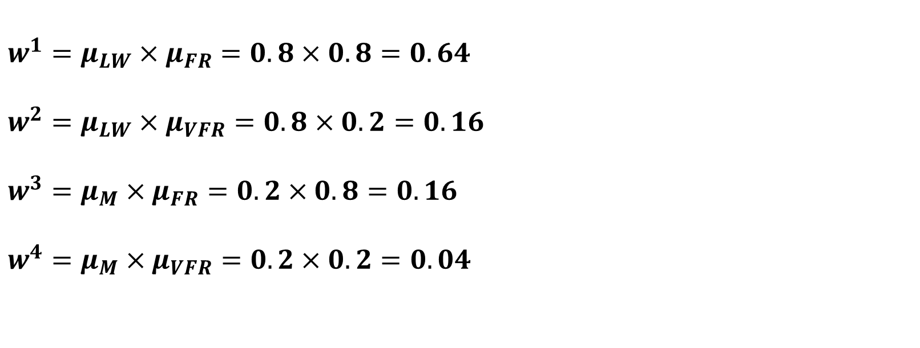
Mean of distance values
$$\overline{d}= \frac{\sum{d_{ij}}}{45}=0.518373$$
$$α= \frac{ln 2}{\overline{d}}=1.337160$$
Similarity between the points i and j
$$S_{ij}= e^{−αd_{ij}}$$

Slide 45
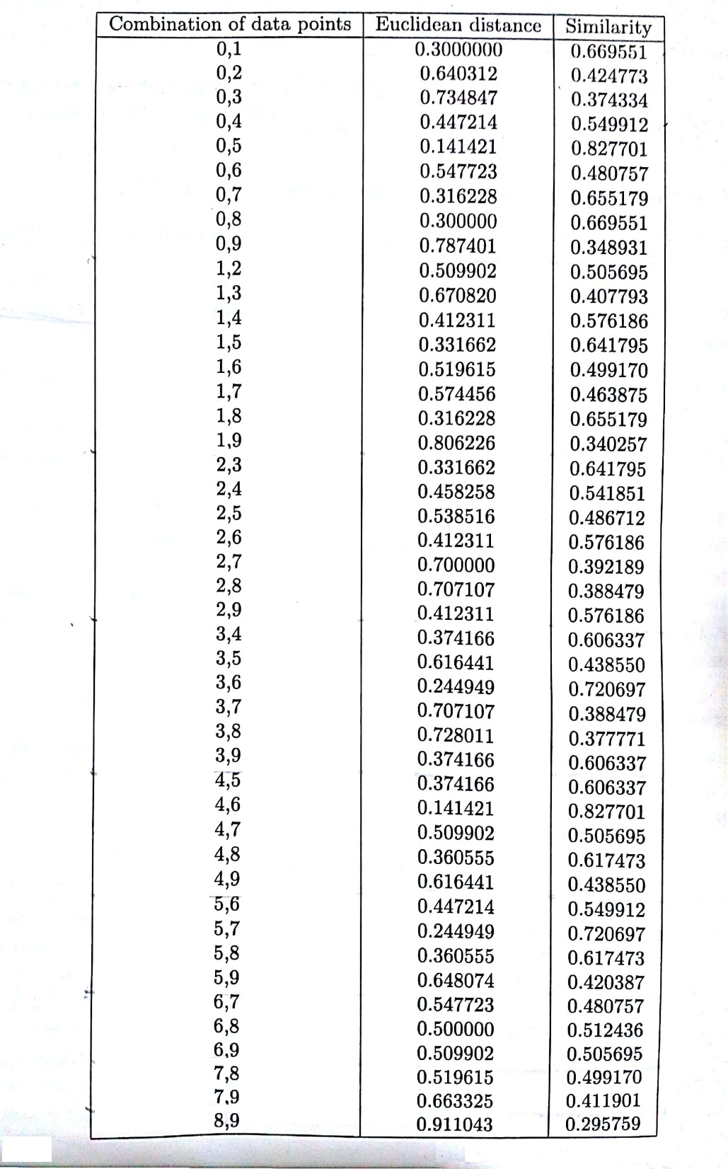
Euclidean distance and similarity values are calculated, as shown in the table.

Slide 49
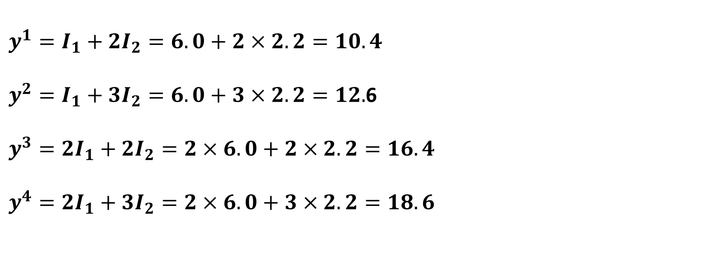
Entropy of i-th data point
$$E_{i}=−\sum_{j∈x}^{j≠i}{(S_{ij}\log_{2}S_{ij}+\left(1−S_{ij}\right)\log_{2}(1−S_{ij}))}$$
Entropy values are found to be as follows:
$$E_{0}=8.285456;E_{1}=8.665640$$
$$E_{2}=8.815512;E_{3}=8.568537$$

Slide 50
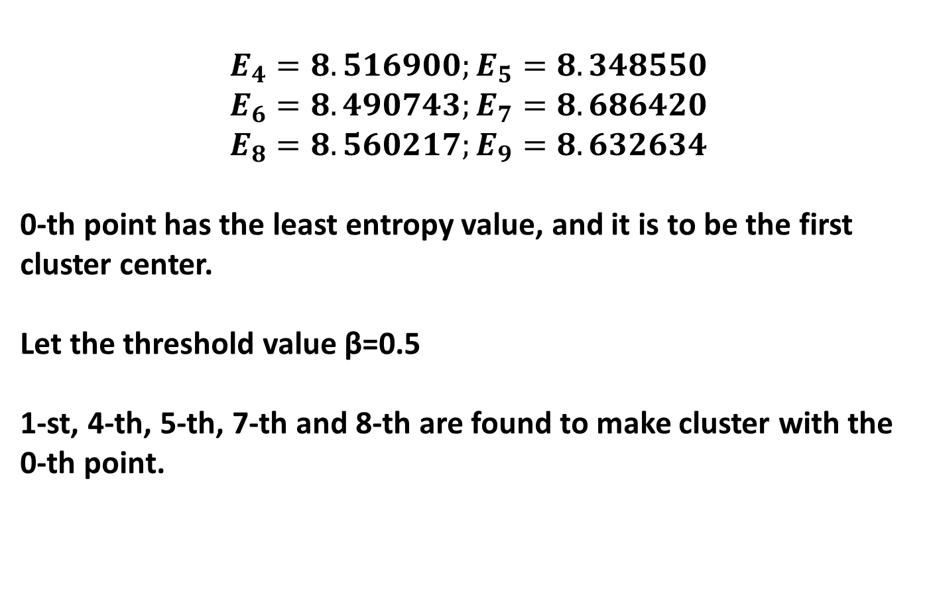
$$E_{4}=8.516900;E_{5}=8.348550$$
$$E_{6}=8.490743;E_{7}=8.686420$$
$$E_{8}=8.560217;E_{9}=8.632634$$
0-th point has the least entropy value, and it is to be the first cluster center.
Let the threshold value β=0.5
1-st, 4-th, 5-th, 7-th and 8-th are found to make cluster with the 0-th point.

Slide 51
Remaining points are : 2-nd, 3-rd, 6-th, 9-th
Out of these four points, the 6-th point is seen to have the least values of entropy.
6-th point: center of second cluster

Slide 52
As β=0.5, 2-nd, 3-rd and 9-th points are seen to make cluster with the 6-th point.
7
5
2
8
0
6
1
3
4
9
1st cluster
2nd cluster

Slide 53
Entropy-Based Fuzzy Clustering
Number and nature/quality of clusters depend on threshold value of similarity
More flexible compared to FCM algorithm
Yields more distinct but less compact clusters
We want more distinct and more compact clusters, for which Entropy-based Fuzzy C-Means Clustering has been proposed
Performances of clustering algorithms are data dependent

Slide 54
References:
Soft Computing: Fundamentals and Applications by D.K. Pratihar, Narosa Publishing House, New-Delhi, 2014
Fuzzy Sets and Fuzzy Logic: Theory and Applications by G.J. Klir, B. Yuan, Prentice Hall, 1995
V. Dey, D.K. Pratihar, G.L. Datta, “Genetic algorithm-tuned entropy-based fuzzy c-means algorithm for obtaining distinct and compact clusters,” Fuzzy Optimization and Decision Making, 10, pp. 153-166, 2011.

Slide 55
Conclusion:
Working principles of Fuzzy Reasoning Tool (Fuzzy Logic Controller) and Fuzzy Clustering have been discussed with suitable numerical examples

